Slide 1
Opening Term Deposit
Improving return rate from marketing campaign
Stakeholders Presentation

Slide 2
Problem
Today, the bank makes campaigns by calling our clients blindly. According to our data, only 11% of clients opened a term deposit. That means 89% of our customers received an unwanted call.
Spam Calls

Slide 3
Spam Calls
Cost us money
Bank’s image
It is… annoying
Every call cost us money. We have a huge database of clients meaning we need a lot of people in our payroll to address this demand.
We need to sell, but we also need to treat our customers with respect and avoid bothering them when we can. According to an anti spam company, last year, spam calls have increased by 56%¹.
Yes… 89% of our clients felt annoyed with our calls. We need to remember they also receive marketing from many other companies.
Is there a way to mitigate this problem?
1. https://truecaller.blog/2019/12/03/truecaller-insights-top-20-countries-affected-by-spam-calls-sms-in-2019/

Slide 4
Solution
Before the model, only 11% of calls resulted in opening a term deposit. With AI, this value is now 52%.
Machine Learning

Slide 5


Slide 6
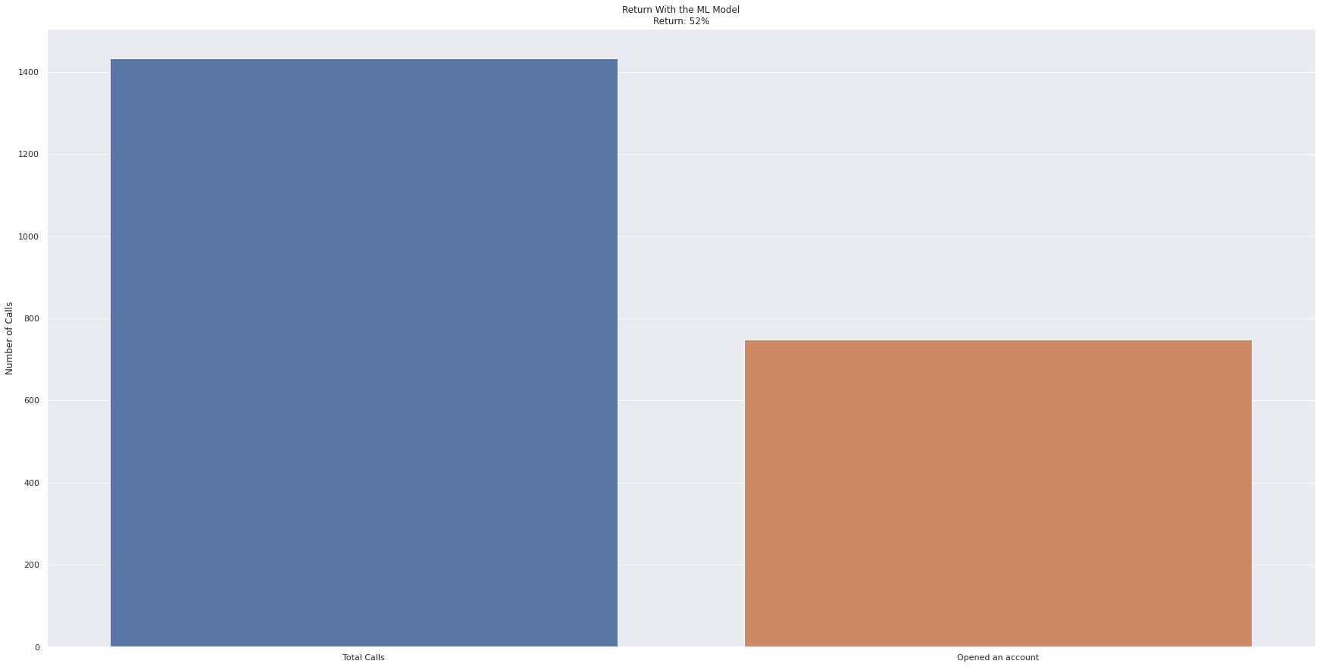

Slide 7
How?
Data
Machine Learning
Target
Customer’s Data
The Bank has a huge database filled with useful information. This data is the entry for our model.
Apply the data
We found out that there is a pattern for clients that open a term deposit. The ML model can use this and tell us who to call.
Call the right person
The model will return for us if the person will or will not open a term deposit with high confidence. It means we can call only the right clients.

Slide 8
We also reduced the number of calls by 88%+

Slide 9
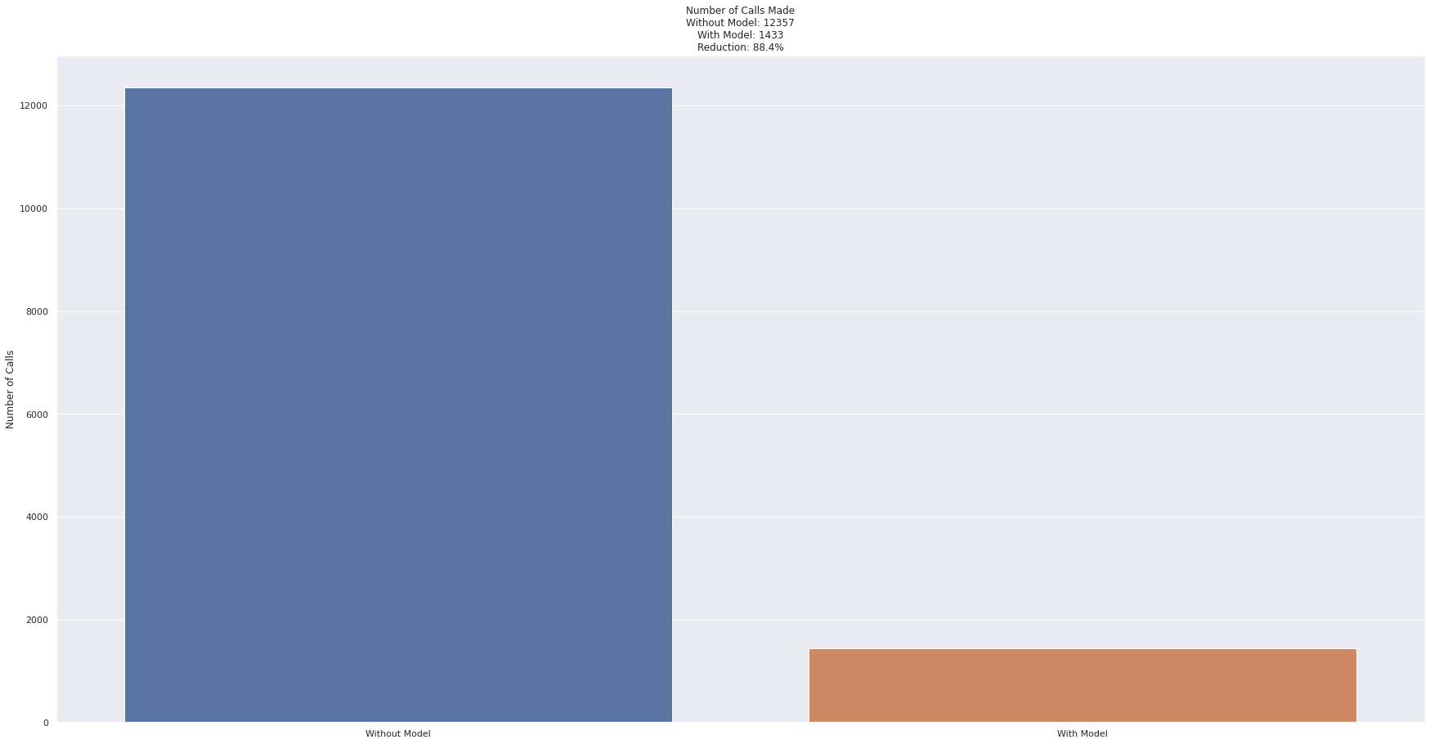

Slide 10
Conclusion
Applying our model, the bank will save money by reducing the number of calls and the number of people doing calls and will increase the return ratio from each call.
Efficiency

